Slide 1
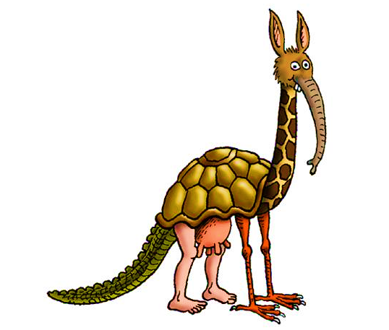
R.I.S.E. – Research. Innovate. Solve. Excel. Hybrid Recommender systems
OWAIS AHMAD
E. Owaiskhan9654@gmail.com
Phone- +91-9515884381

Slide 2
Contents
Definition
Problem Statement
Ways its can be Build
Data Description
Exploratory Data Analysis
The final Solution Approach

Slide 3
What is it?
Recommender systems are a technological proxy for a social process.
Recommender systems are a way of suggesting like or similar items and ideas to a users specific way of thinking.
Recommender systems try to automate aspects of a completely different information discovery model where people try to find other people with similar tastes and then ask them to suggest new things.

Slide 4
Problem Statement in R.I.S.E Sony Challenge
An XYZ company has recently started its own OTT platform. The platform is getting a lot of user attention.
Now, in order to increase user engagement and provide them with a personalized content experience, the company is looking for bright minds who can help them develop an advanced content recommendation system.
Your task is to develop a content recommendation system that can give the top 10 recommendations for each user in the test data.

Slide 5
Recommender System Can be Build using Three Ways
Collaborative/Social-filtering system – Aggregation of consumers’ preferences and recommendations to other users based on similarity in behavioral patterns
Content-based system – Supervised machine learning used to induce a classifier to discriminate between interesting and uninteresting items for the user
Knowledge-based system (Hybrid) – Knowledge about users and products used to reason what meets the user’s requirements, using discrimination tree, decision support tools, case-based reasoning (CBR)

Slide 6
Data Description and Exploratory Data Analysis
Three Comma Separated Values are provided in this challenge and using those only I have build this recommender System.
Users CSV contains 13843 x 5 cells.
Content CSV contains 48645 X 9 cells.
Relationship CSV contains 1654450 X 6 cells.
In next few Slides I have presented some Exploratory Data Analysis Which I have performed.

Slide 7
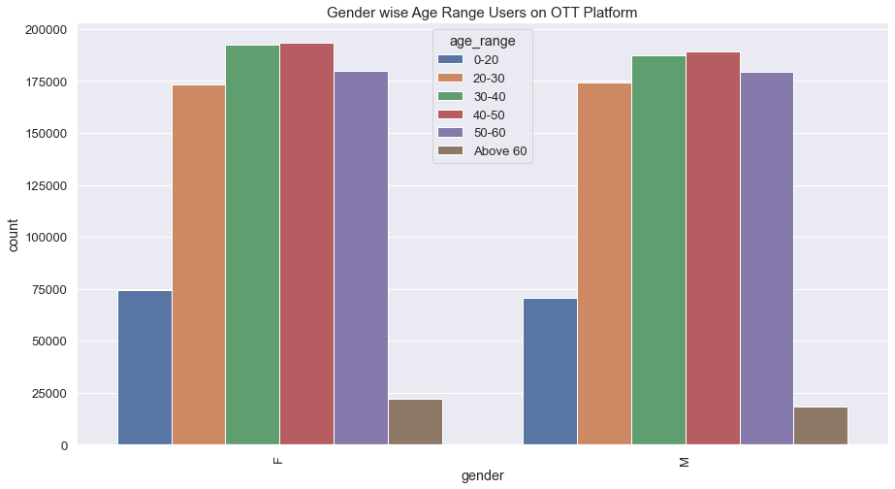
Gender Distribution of Age Range Users on OTT Platform

Slide 8
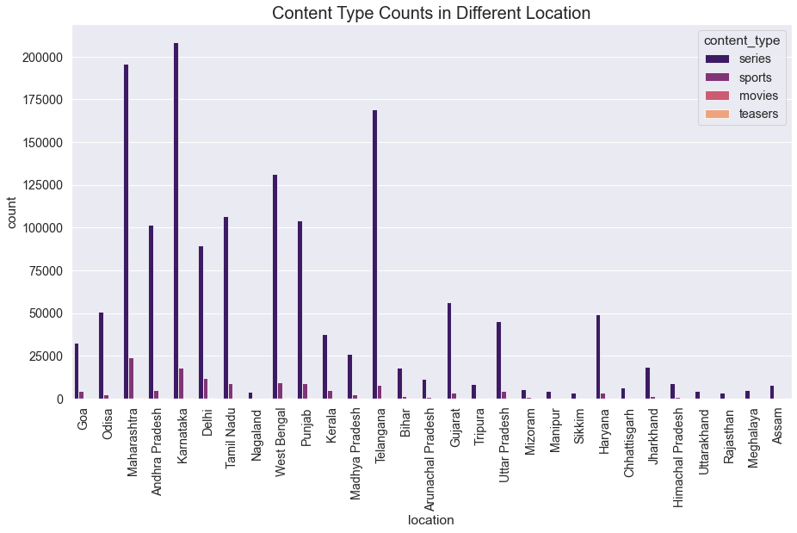
Content Type User Watched History for different Locations

Slide 9
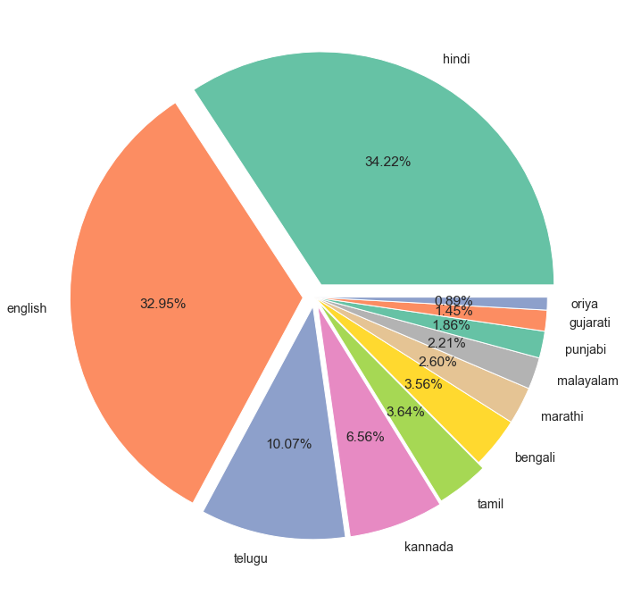
Language Based user watched Content for our systems

Slide 10
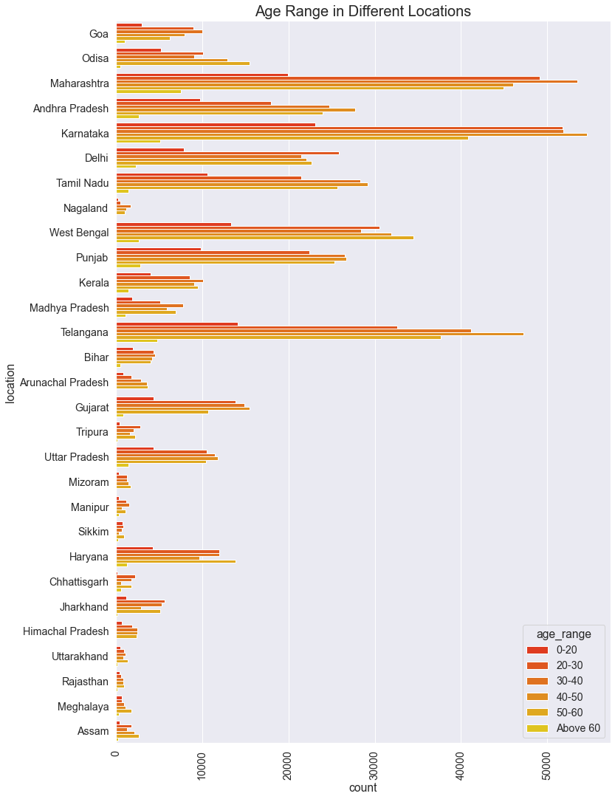
Age Range Count Plot in Different Locations

Slide 11
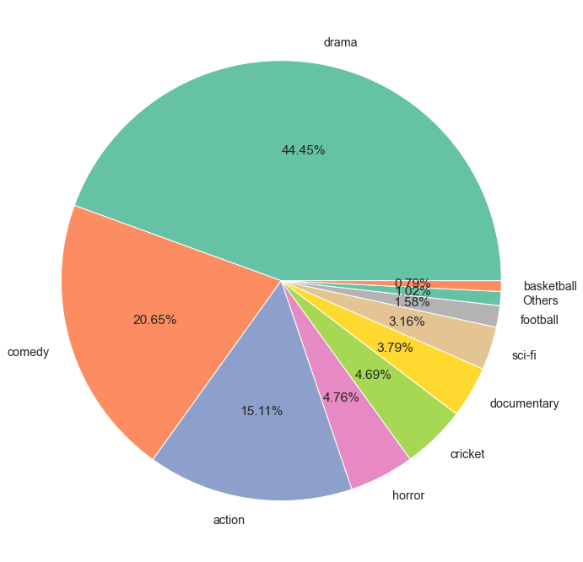
Genre Based user watched Content for our systems

Slide 12
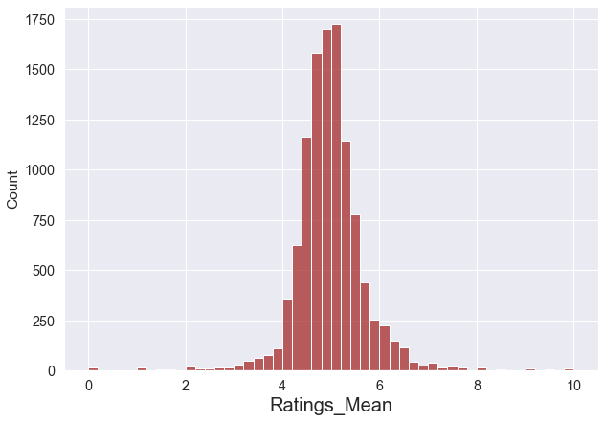
Ratings Mean Kernel Density Estimation Plot

Slide 13
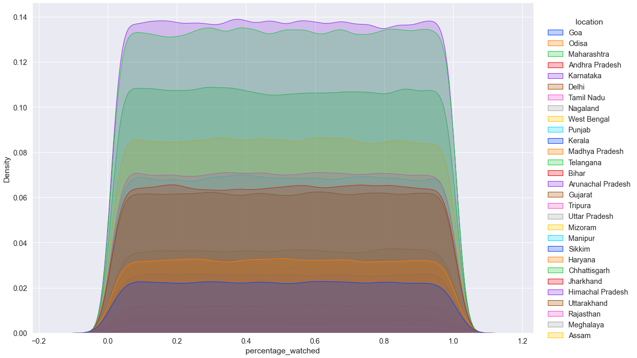
Percentage Watched Density Distribution of Different States

Slide 14
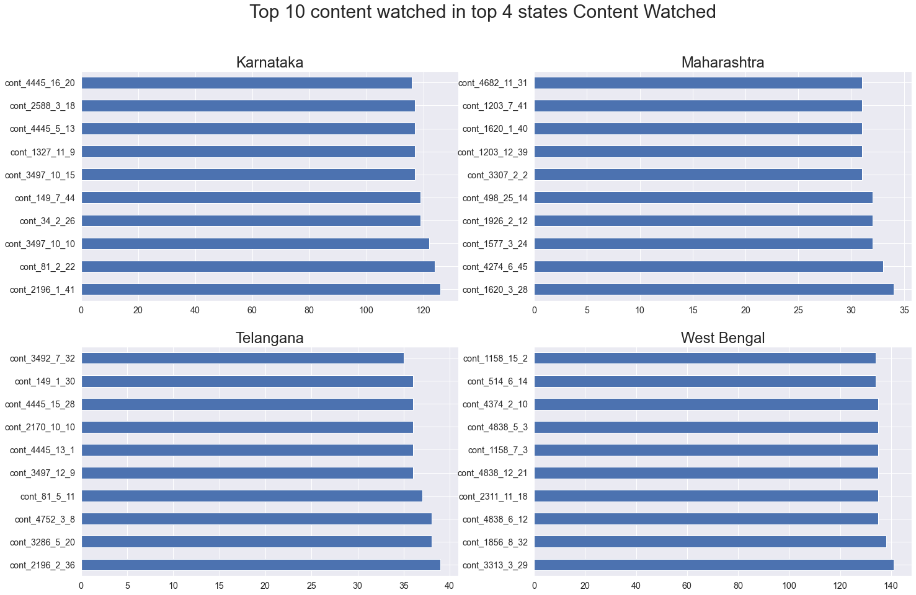
Top 10 Content Count watched in 4 Different states

Slide 15
Content-based Collaborative Hybrid Information Filtering
Feature Extractions and Selection
Percentage watched – Out of Total Size of movie how much Percentage user has watched.
User Joined Days –How much days ago User has joined the OTT Platform.
Movie Old Days – From the day movie has been Launched the user is watching the content
Age Range – In which range of Age user belongs to the category.
Learning to Rank/Recommend Model –Based on the State Location and the Top most Rated movie what are the most watched Content watched by most user is to be Recommended to the New User.

Slide 16
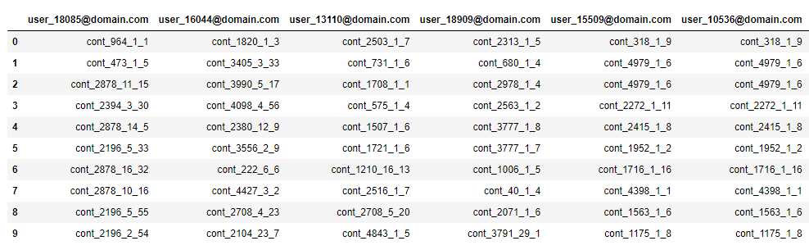
Sample Recommended Content Ids for Different users

